Slide 1
Concepts learned in the last class
Empirical formula
Molecular formula
Molecular mass
Mole (of a compound)
Molar mass (of a compound)
% composition from molecular formula
Molecular formula from % composition and molar mass
Notes:
Chemistry 140 Fall 2002

Slide 2
Example: C₂HBrClF₃
How many milliliters of halothane (d = 1.871 g/mL) would contain 1.00 x 10²⁴ Br atoms?
How many moles of Br?
1.00 x 10²⁴ Br atoms/6.022 x 10²³ atoms/mol = 1.66 moles of Br
2. How many moles of halothane?
Since there is one Br atom per molecule of halothane,
moles of Br = moles of halothane
Moles of halothane = 1.66
3. How many grams of halothane?
Mass of halothane = moles of halothane x molar mass of halothane
Molar mass = 2(12.0107) + 1.0079 + 79.904 + 35.453 + 3(18.9984) = 197.418 g
1.66 moles of halothane x 197.418 g/mole of halothane = 327.713 g of halothane
4. How many milliliters of halothane?
Volume of halothane = 327.713 g x 1/(1.871 g/ml) = 175.154

Slide 3
% Compositions from the Chemical formula
The Chemical formula tells us the % composition of a compound.
H₂O Molar mass of H₂O = 18.01528 g
18.01528 g of H₂O contain 2.01588 g of H and 15.9994 g of O
% of O = (15.9994 g/18.01528 g) x 100 = 88.8%
% H + % O = 100% so, % of H = 11.2%
General Chemistry: Chapter 3
Copyright © 2011 Pearson Canada Inc.

Slide 4
Finding the formula of a compound from experimentally determined % composition
2-deoxyribose has 44.77%C, 7.52% H and 47.71% O
and a molecular mass of 134.1 u.
What is its molecular formula?
Example:
Assume a 100.0g sample of 2-deoxyribose, then it contains:
44.77 g of C, 7.52 g of H and 47.71 g of O
2. Find the moles of each element:
Moles of C = 44.77 g of C/ (12.011 g/mol) = 3.727 mol of C
Moles of H = 7.52 g of H/ (1.008 g/mol) = 7.46 mol of H
Moles of O = 47.71 g O/ (15.999 g/mol) = 2.982 mol of O
3. Write a tentative formula:
C_{3.727}H_{7.46}O_{2.982}
Notes:
Chemistry 140 Fall 2002
If you know the molecular wt it is beneficial to choose that number, then only first three steps are required.

Slide 5
Finding the formula of a compound from experimentally determined % composition
2-deoxyribose has 44.77%C, 7.52% H and 47.71% O
and a molecular mass of 134.1 u
What is its molecular formula?
Example:
4. Real formula must be a combination of small whole numbers of atoms, so we must transform the subscripts to small whole numbers.
First, divide all subscripts by the smallest and re-write the formula:
C_{1.25}H_{2.50}O_{1.00}
5. Multiply each of the subscripts by small numbers until all the subscripts are whole numbers
Multiply each of the subscripts by 4: C₅H₁₀O₄ (empirical formula)
6. Find the molecular mass of the compound and compare to the value given. If they are equal, then this is the chemical formula for 2-deoxyribose.
Chemical formula is: C₅H₁₀O₄
Notes:
Chemistry 140 Fall 2002
If you know the molecular wt it is beneficial to choose that number, then only first three steps are required.

Slide 6
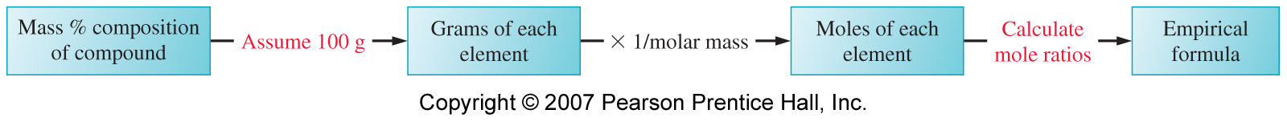
Summary of steps:
Choose an arbitrary sample size (100g is preferred).
Convert masses of each element to amounts in moles.
Write a tentative formula.
Convert formula to small whole numbers by dividing all numbers by the smallest number of moles in formula.
Multiply all subscripts by small whole numbers to make the subscripts integral. (empirical formula)
To determine the molecular formula, must know the molecular mass & compare it to the empirical formula mass.
General Chemistry: Chapter 3
Copyright © 2011 Pearson Canada Inc.
Notes:
Chemistry 140 Fall 2002
If you know the molecular wt it is beneficial to choose that number, then only first three steps are required.

Slide 7
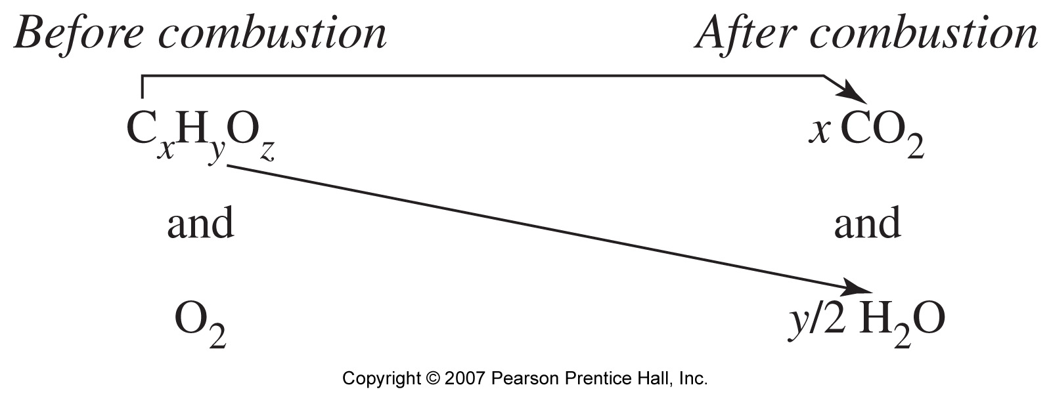
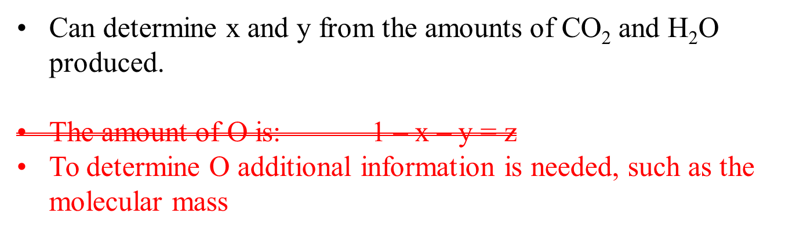
Combustion Analysis: common way to find % compositions of unknown compounds
General Chemistry: Chapter 3
Copyright © 2011 Pearson Canada Inc.
Notes:
Chemistry 140 Fall 2002
Water vapour absorbed by magnesium perchlorate
Carbon dioxide absorbed by sodium hydroxide.
The differences in mass of the absorbers before and after yiled the masses of water and CO₂ produced in the reaction
Combustion takes place in an excess of oxygen so you cannot measure oxygen. Oxygen CAN be analyzed separately but is usually determined by difference.

Slide 8
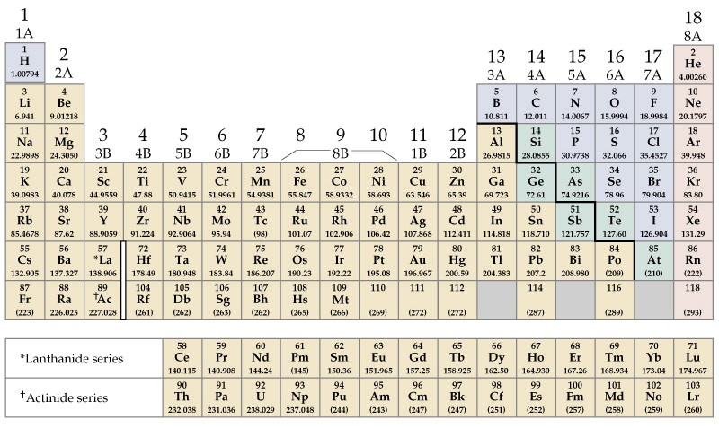
3-4 Oxidation States: A Useful Tool in Describing Chemical Compounds
Metals tend to lose electrons.
Na   Na⁺ + e⁻
Non-metals tend to gain electrons.
Cl + e⁻ Cl⁻
Reducing agents
Oxidizing agents
In a compound, electrons are lost by one atom and gained by the other. Sometimes electrons are shared between two atoms.
Oxidation state is related to the number of electrons that an atom gains or loses, or appears to use, when joining with other atoms.
Need rules to assign oxidation states (OS)
Notes:
Chemistry 140 Fall 2002
Metals are electron sources
Non-metals are electron sinks
Sodium goes to the +1 oxidation state
Chlorine goes tot eh –1 oxidation state

Slide 9
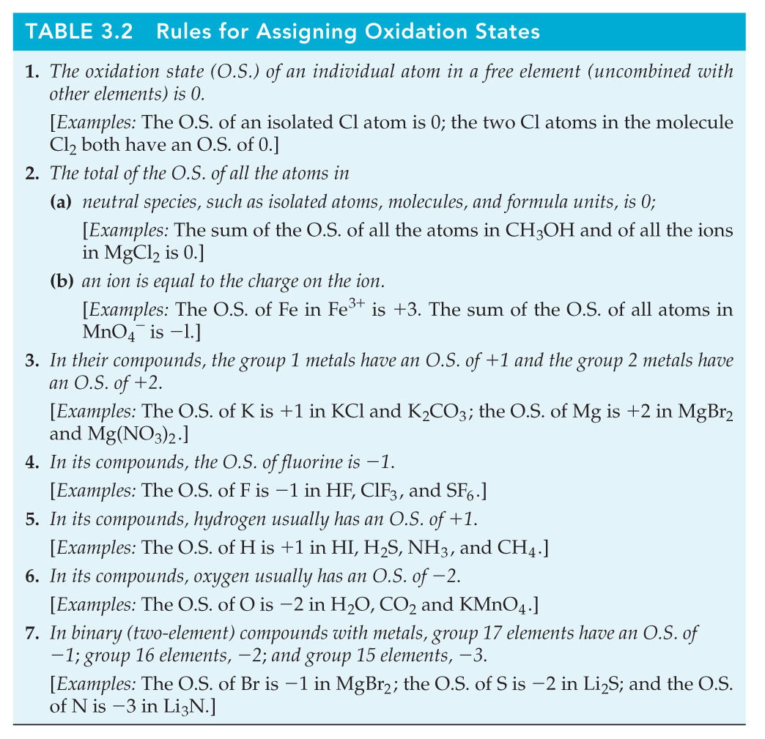
Fe⁰
H₂⁰
For H₂O, must add up to zero
For NO₃⁻, must add up to −1
Li⁺¹
Na⁺¹
Ca⁺²
etc.
Apply rules sequentially!

Slide 10
Assigning Oxidation States
P₄ NaH MnO₄ –
P⁰ Na⁺¹ O⁻² (4 O atoms)
H⁻¹ Mn⁺⁷
Hg₂Cl₂ H₂O H₂O₂
Cl⁻¹ H⁺¹ H⁺¹
Hg⁺¹ O⁻² O⁻¹

